Slide 1

eyeLearn
Andrew Jiang, Sharanya Pulapura, Nabib Ahmed, David Xu

Slide 2
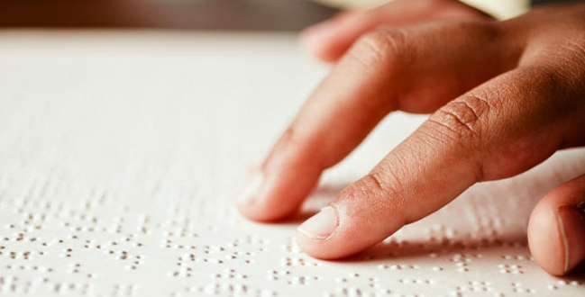
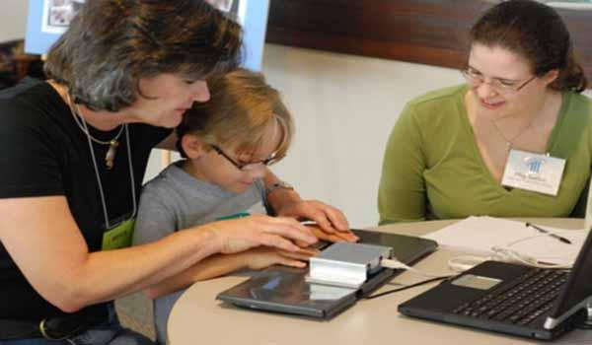
Motivation and Goals
Help visually impaired
Create a device that
Allows blind students to learn Braille
Allows interested, seeing people to learn Braille.
Improve pedagogy for visual impaired.
Promote awareness of visual impairment.

Slide 3
